Slide 1
Review Analyzing
Aaron Zhao

Slide 2
Content
Data Processing
Brief Analysis

Slide 3
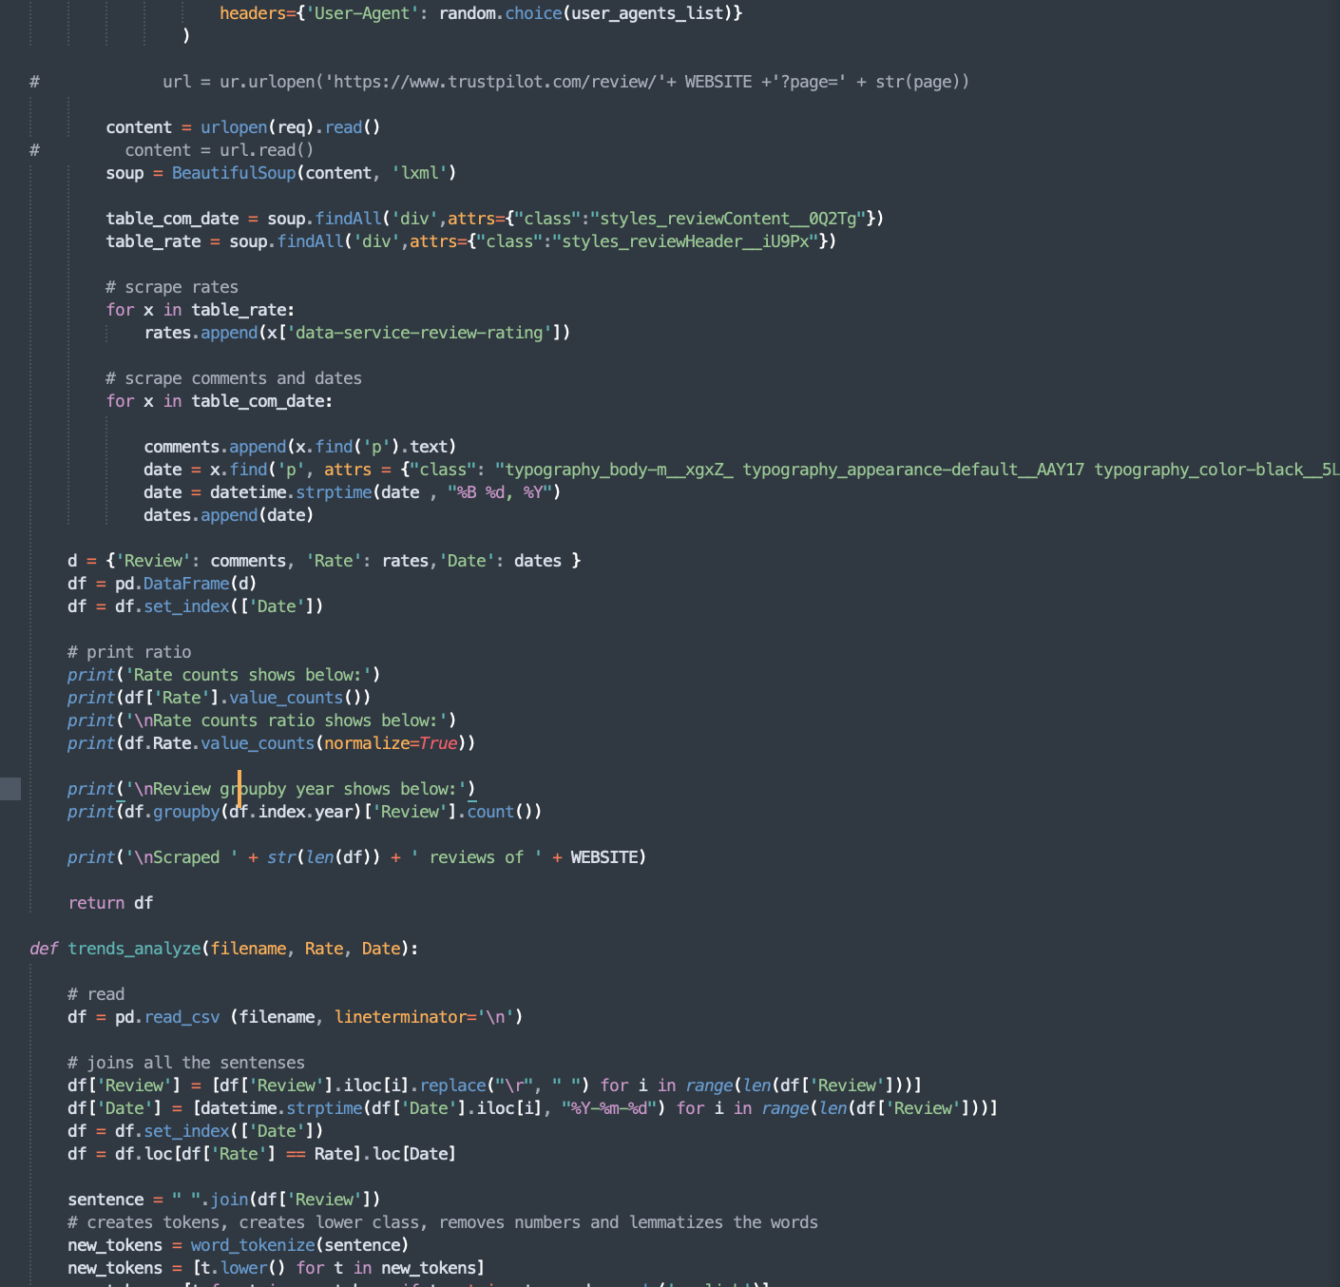
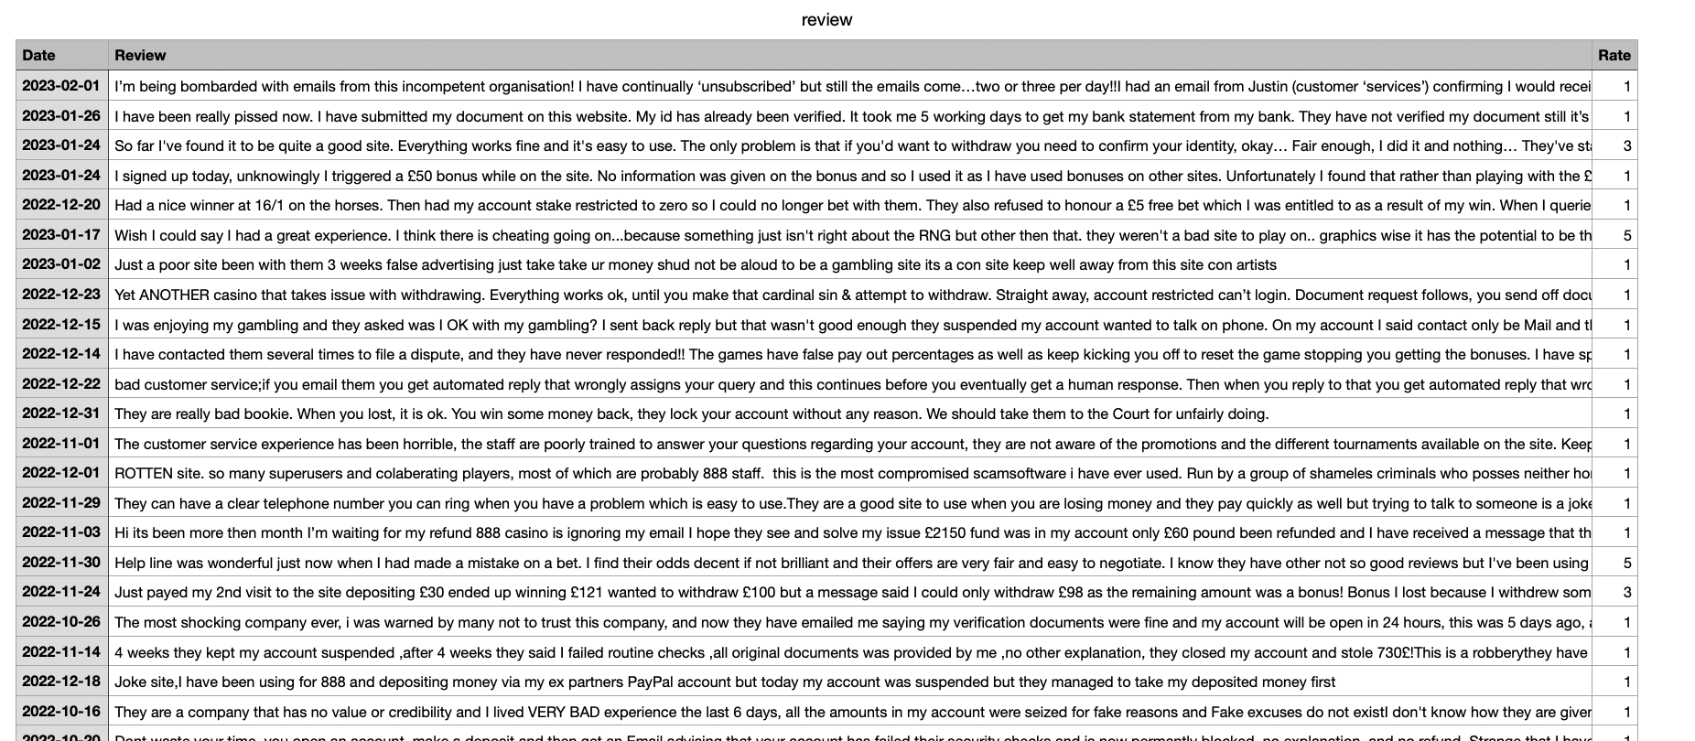
CASE 2 | DATA PROCESSING
Data Scraping
Trends Analyze
Review Star Split
Plot Review Volume
Plot Charts
Code
Reviews
My wordflow is shown as above and please find my code in the folder Second Case Study/website scrape
I scraped: ['www.888.com', 'www.ladbrokes.com', 'www.skybet.com', 'www.paddypower.com', 'williamhill.com']

Slide 4
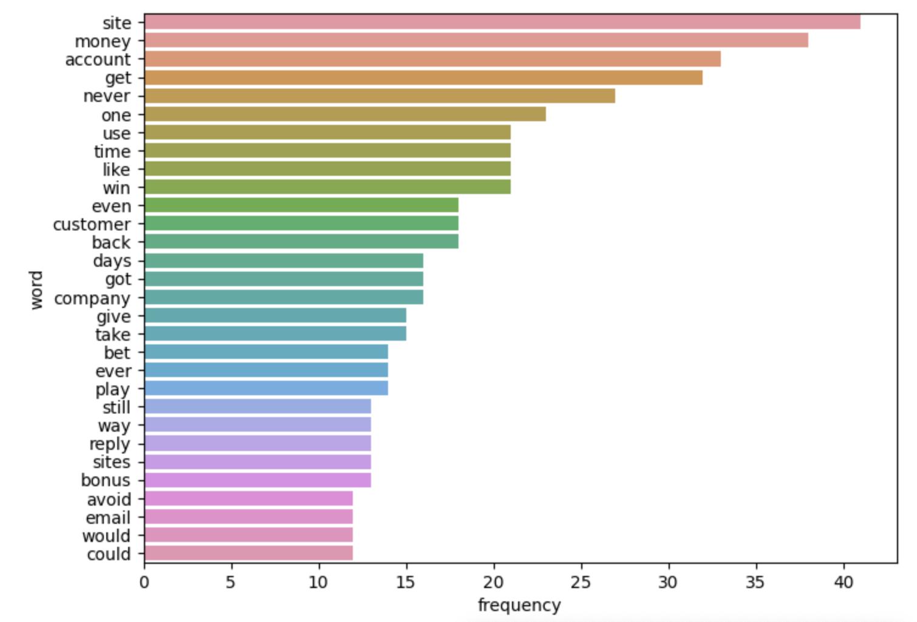
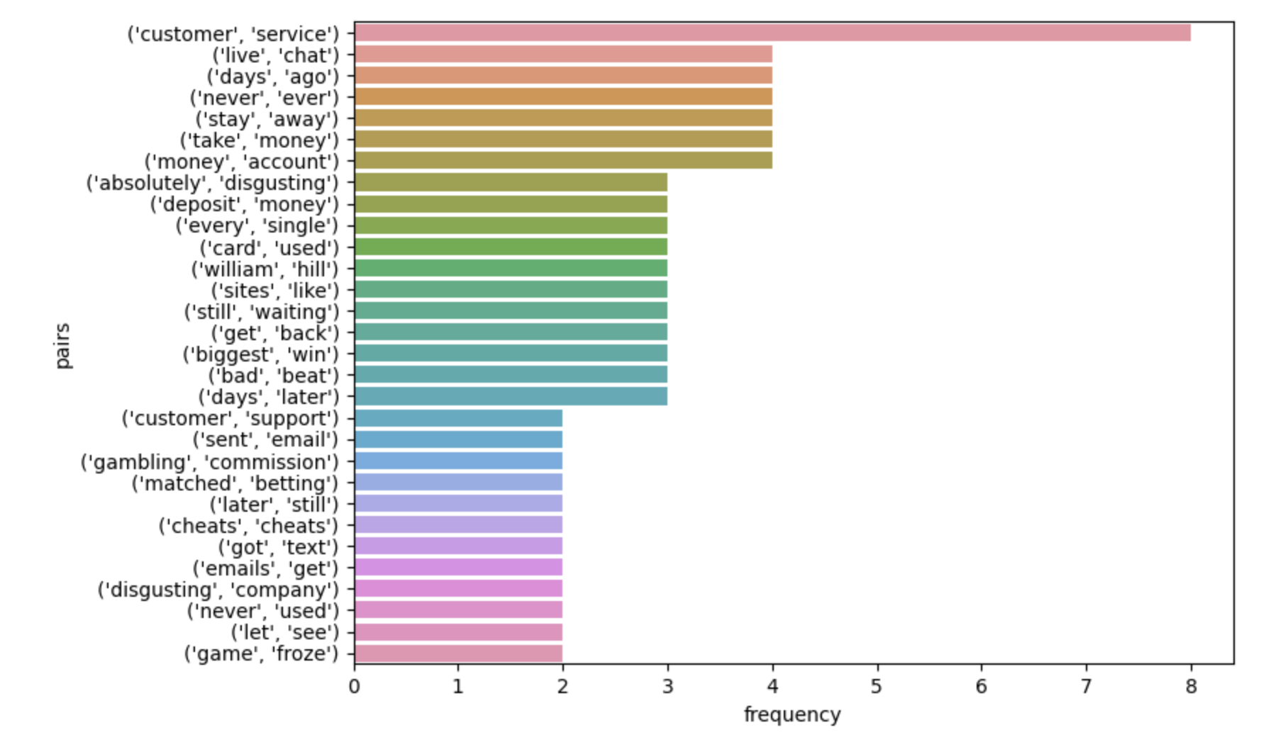
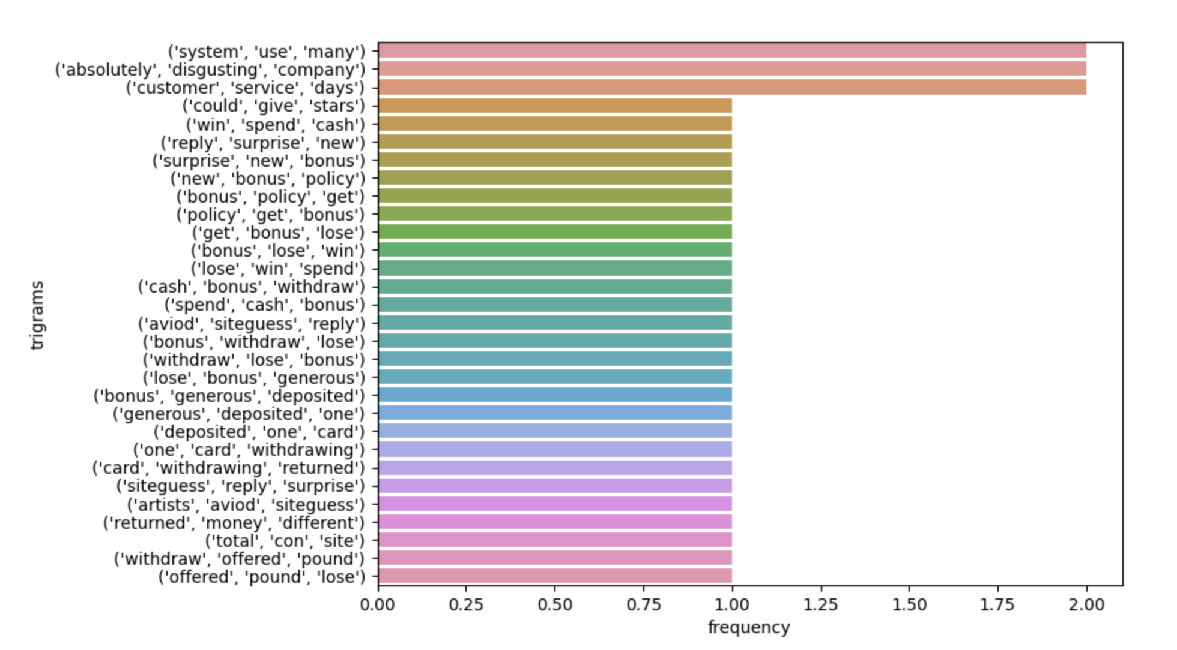
CASE 2 | BRIEF ANALYSIS
Figures: Rate = 1, 2020, but multiple years analysis were conducted
Each company’s review throughout these 10 years are firstly analyzed and keywords are extracted to get to know what excites customers and what frustrated customers. We can somehow find a tendency that most of the ppl complained about the customer services, couldn’t get their money back, and the betting system was unfair.
In my code, you can type a rate, 1, for example, and type 2020 to see what frustrated customers in 2020.

Slide 5
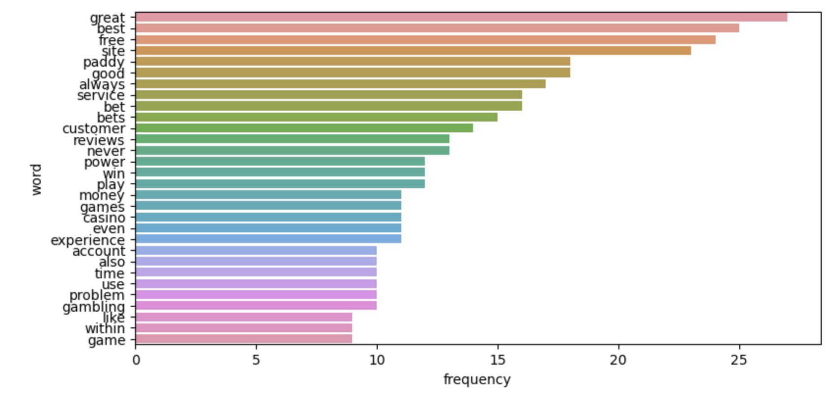
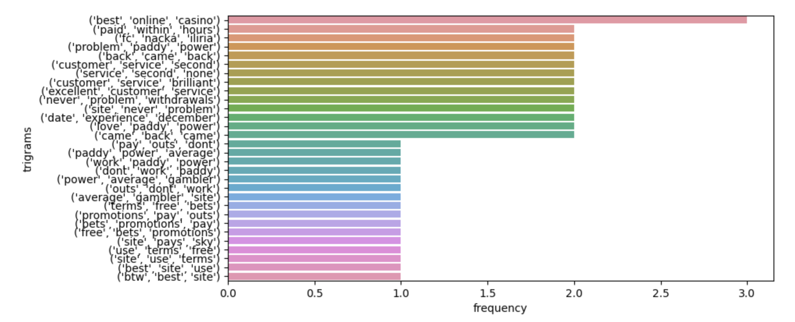
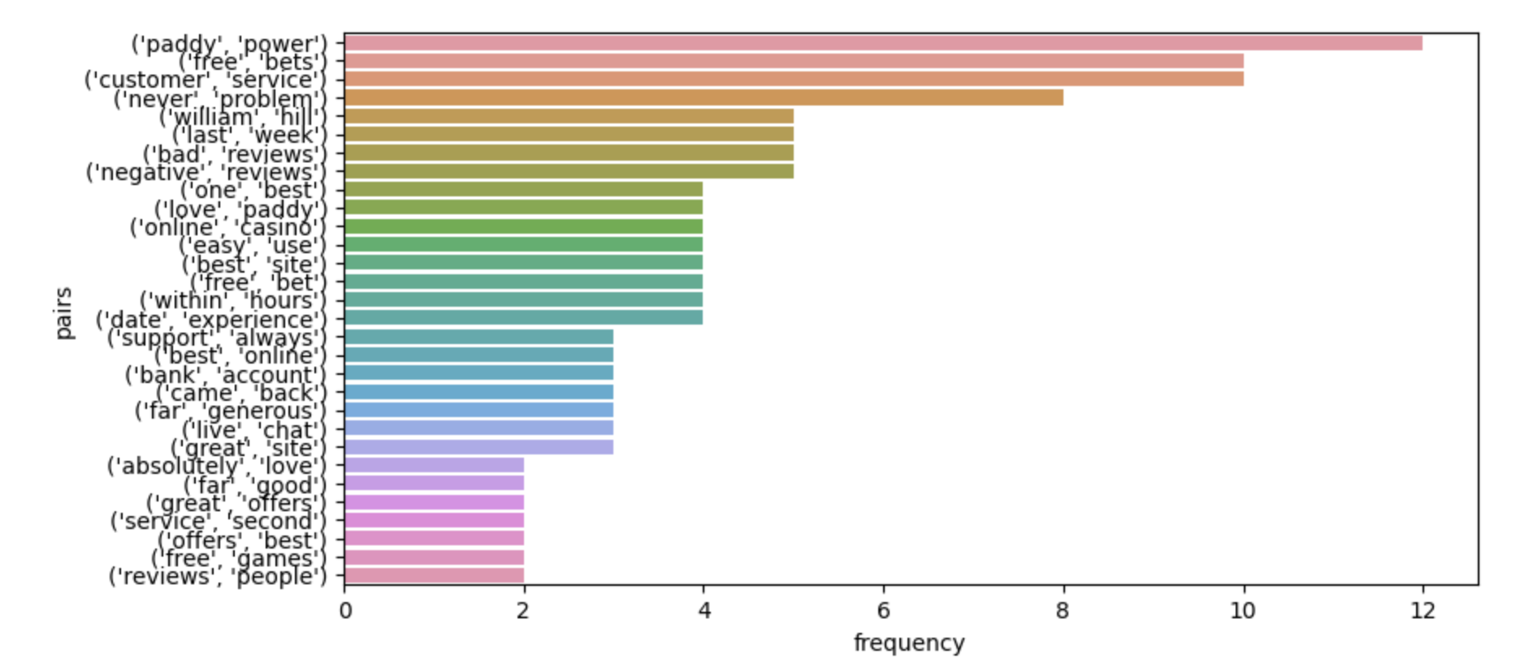
CASE 2 | BRIEF ANALYSIS
Figures: Rate = 5, 2020, but multiple years analysis were conducted
Also, in order to know what excites the customer, I conducted an analysis on rate 4 and 5 and found results as these. People are happy because their money can be withdrawn quickly , the customer service is live and fast, and the app is easy to use.
Overlap Analysis can also be conducted if time permits, reviews and keywords should be cross compared
Also, TrustPilot was a little bit sensitive, I was banned a few times while scraping it, number of reviews then limited

Slide 6
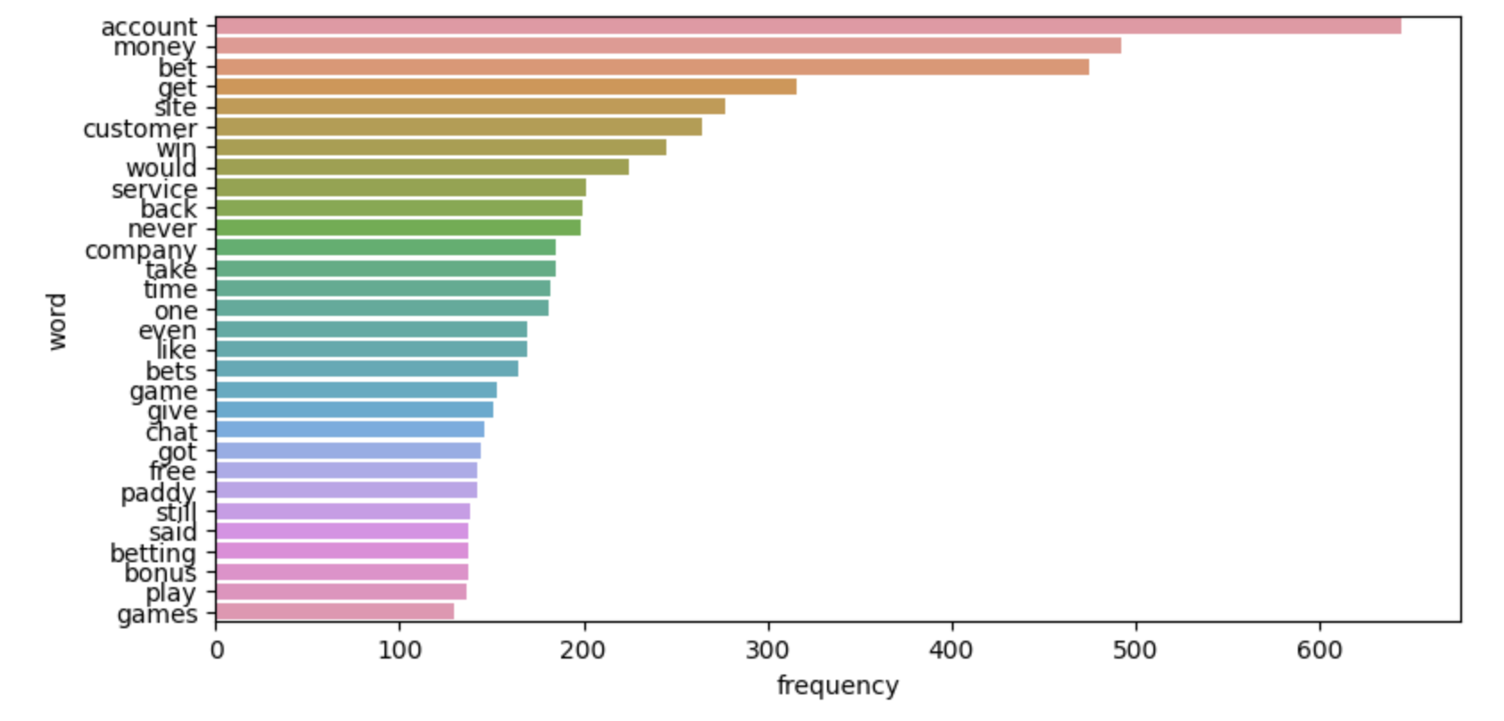
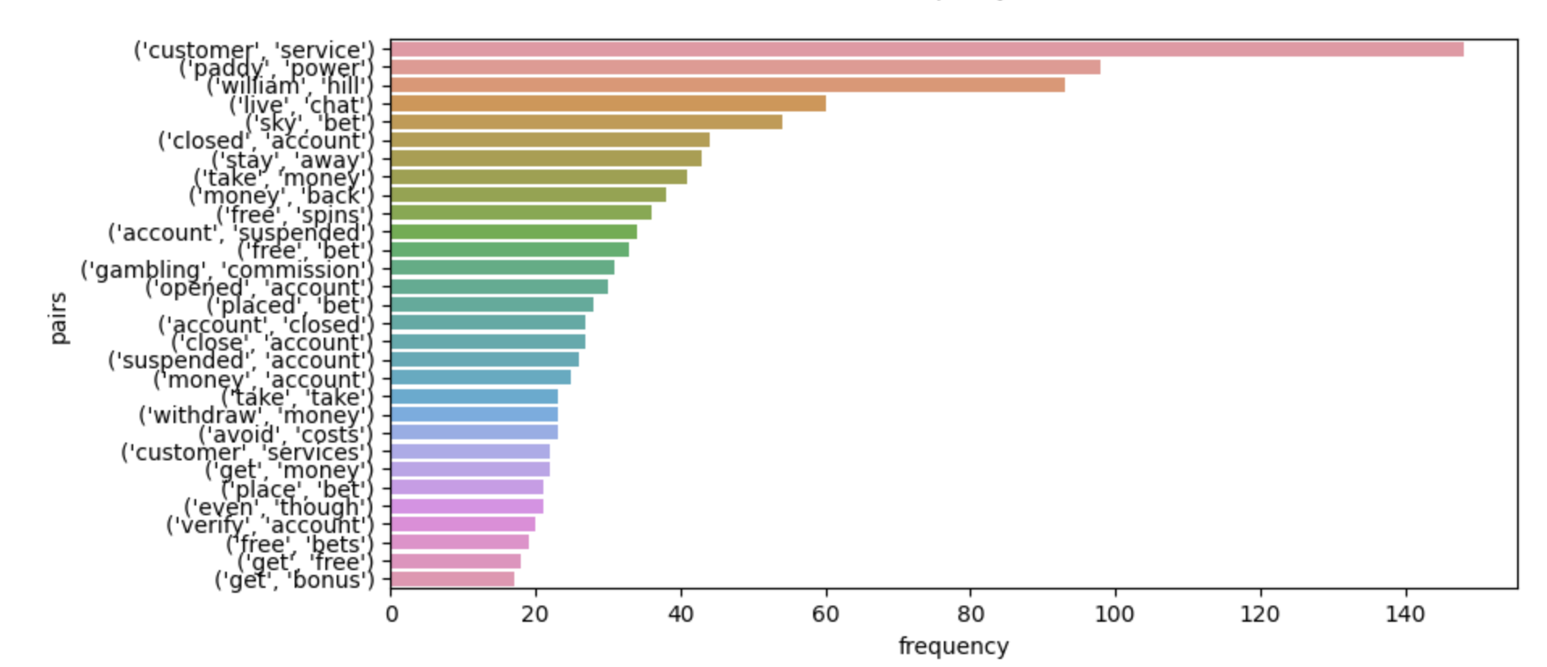
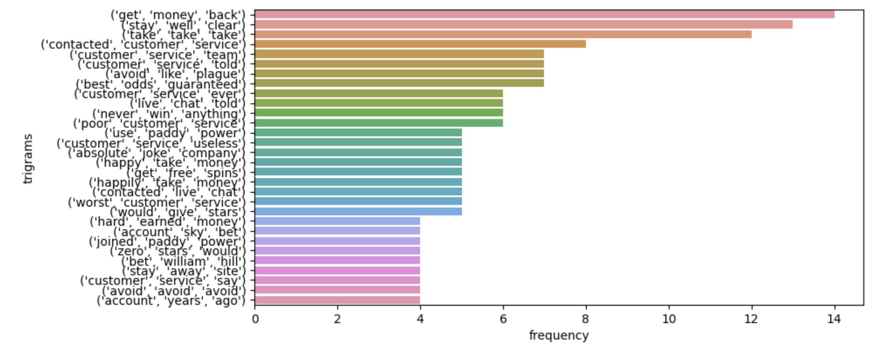
CASE 2 | BRIEF ANALYSIS
I combined all the reviews of 5 betting companies since their average rates are all somewhere 2/5. I want to see whether the reviews are consistent or diverse. The plots I plotted has pretty much the same as the graphs of single company. Ppl complained about customer service, closed account, couldn’t get their money back.

Slide 7
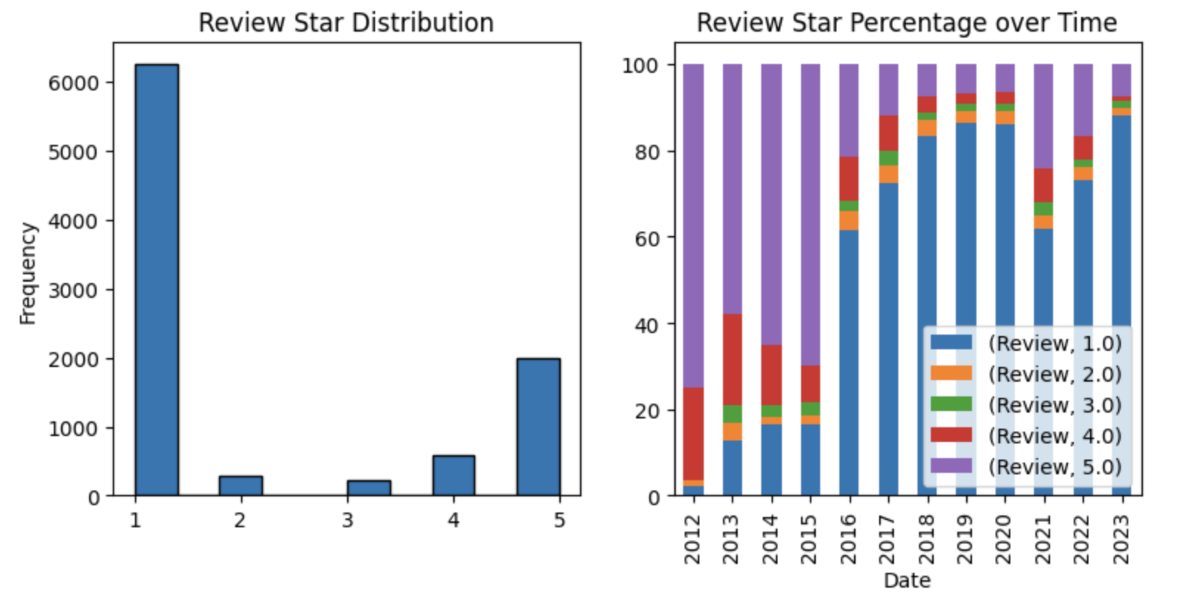
CASE 2 | BRIEF ANALYSIS
I also conducted a review star distribution to see the change of review stars in the past 10 years.
We can see a clear tendency that 8.9 years ago, people are pretty happy with the apps (couldn’t tell whether the reviews are fake or real). During somewhere in 2016, people started abandon these apps and the average rate went down

Slide 8
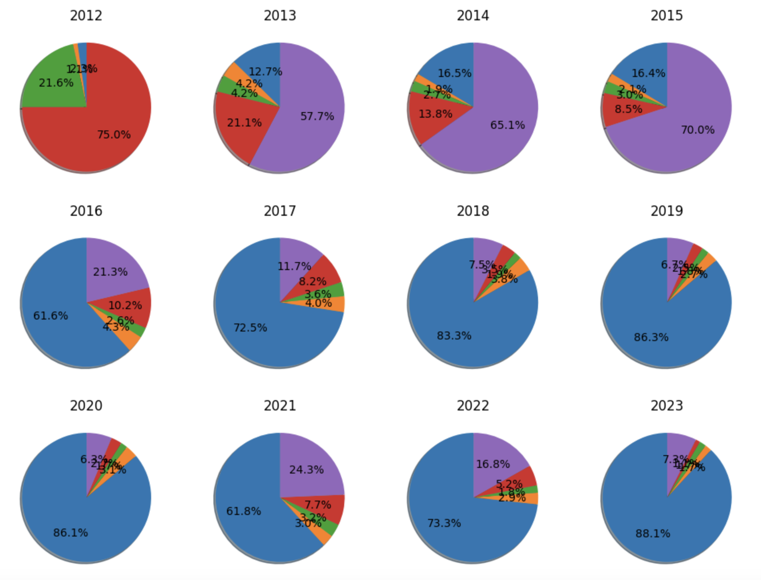
CASE 2 | BRIEF ANALYSIS
I also conducted a review star distribution to see the change of review stars in the past 10 years.
We can see a clear tendency that 8.9 years ago, people are pretty happy with the apps (couldn’t tell whether the reviews are fake or real). During somewhere in 2016, people started abandon these apps and the average rate went down

Slide 9
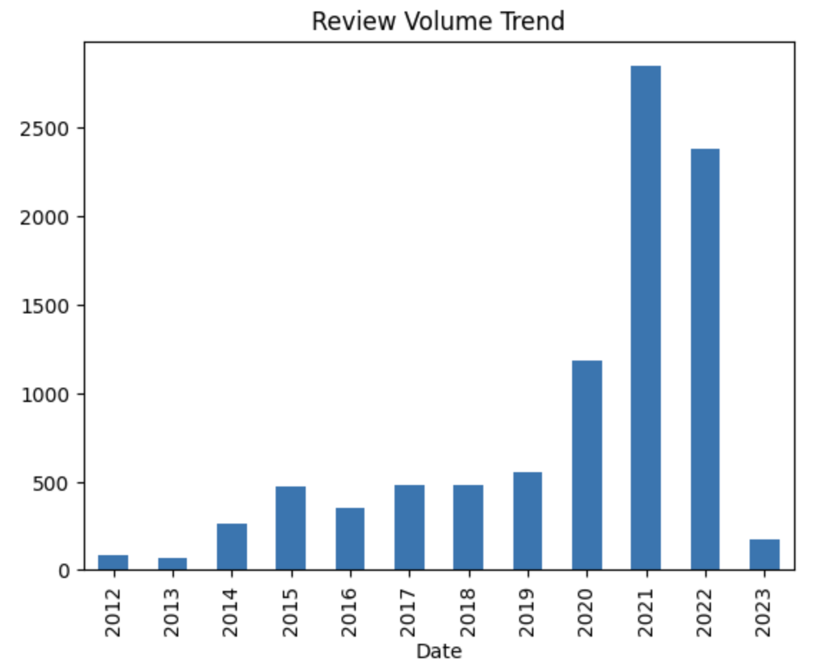
CASE 2 | BRIEF ANALYSIS
A review volume trend was also conducted. We can see a pattern that people are reviewing more on these companies to express themselves.
People’s review are exponentially increasing thru the past 5 years, which can be seen as an indicator that the user base of these companies are growing and more people are using sports betting apps

